Slide 1
For a genuine European Health Union
December 2021
Vytenis Povilas Andriukaitis

Slide 2
For the genesis of strong international cooperation for health we may look to the Constitution of WHO adopted in July 1946
A principle “The health of all peoples is fundamental to the attainment of peace and security and is dependent upon the fullest COOPERATION OF individuals and STATES” is enshrined in the Constitution.

Slide 3
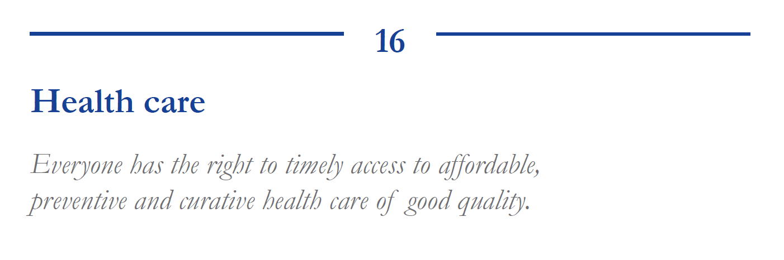
The European Pillar of Social Rights

Slide 4
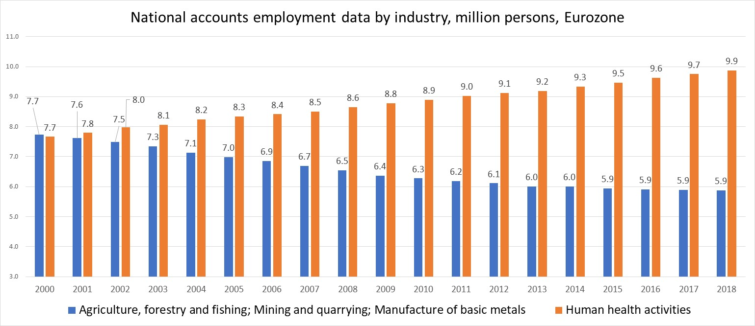
Employment in health is almost twice bigger than in sectors of economy that shaped Europe at the beginning of the European project
Source. Eurostat

Slide 5
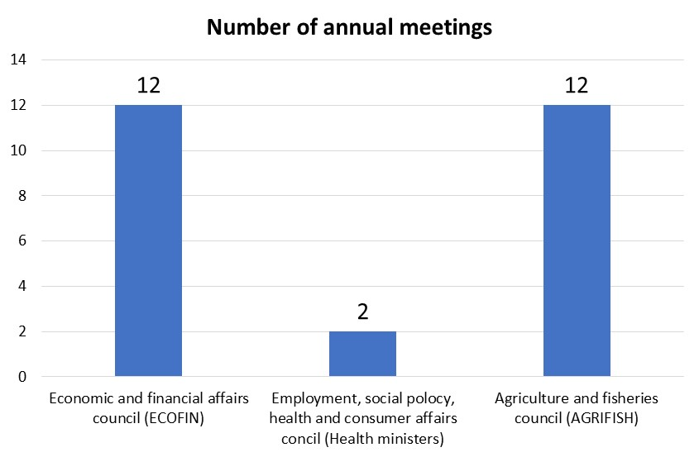
Health is marginal issue in the European semester

Slide 6
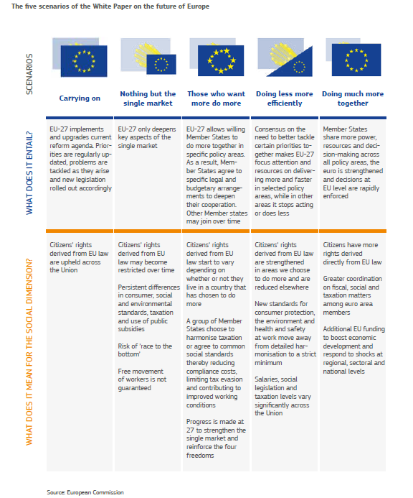
Before COVID-19 health was out of agenda on the future of Europe

Slide 7
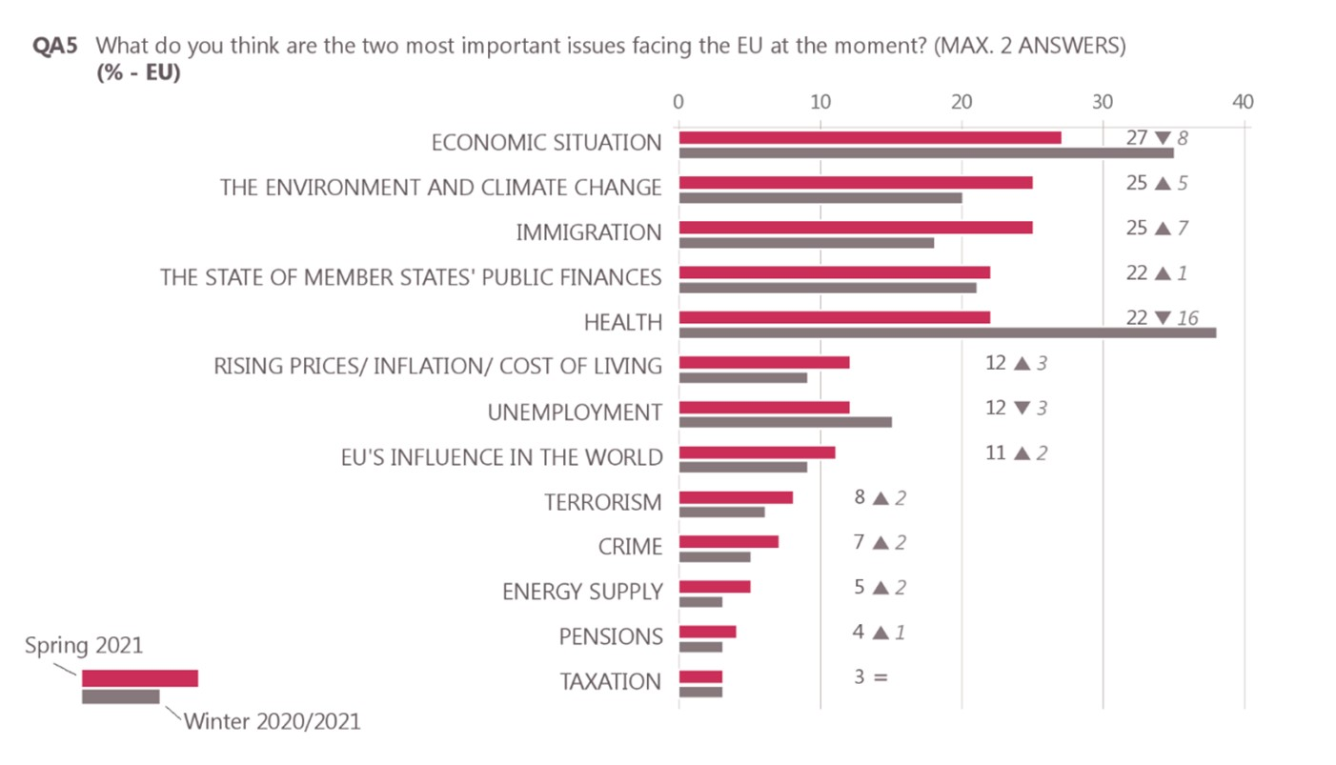
COVID-19 elevated health into 5 top priorities of Europeans. Before the pandemic Eurobarometer was not asking about the importance of health
Source. Standard Eurobarometer 95 Spring 2021

Slide 8
Politicians have noted the change of popular preferences
Year 2017. EC White Paper on the Future of Europe. None of five scenarios was speaking about health as a priority for the block.
Early Spring 2020. Few “dreamers” dared to call for the stronger representation of health in European Treaties. May 2020. EP started to discuss issues related to the EHU.
September 2020. the European Commission President, Dr Ursula von der Leyen, has called for a European Health Union. “For me, it is crystal clear - we need to build a stronger European Health Union”
October 2020. The Manifesto for a European Health Union and Explanatory Memorandum for a European Health Union.
April 2021. German Chancellor Angela Merkel indicated that she does “not rule out a treaty change”.
Autumn 2021. EHU is present as one of the important topics on the Conference of the Future of Europe.

Slide 9
Rationale for stronger European health policy for a EHU

Slide 10
Communicable diseases do not respect political borders. No one is safe until everyone is safe
For the victory against pandemic, regional and global cooperation is key. Why not to use the EU as one of already existing instruments?
Ebola, Zika, and COVID-19 are teaching us that international preparedness for health crisis should be permanent.
Infectious diseases are killing much more people than wars. Why is health usually discussed just during rare meetings of ministers of Health while military preparedness is constantly on radars of politics?

Slide 11
Health is a multidimensional issue with different actors best suited to play different roles. Pan European cooperation has its roles
The evidence already generated by the European Reference Networks (ERNs) for rare diseases shows that pan European cooperation helps more than 30 million EU residents suffering from rare diseases and rare cancers, most of the EU Member States are simply too small to develop needed infrastructure.
Markets are not fit to produce orphan drugs without public support. US Orphan Drug Act of 1983 states: ”because so few individuals are affected by any one rare disease or condition, a pharmaceutical company which develops an orphan drug may reasonably expect the drug to generate relatively small sales in comparison to the cost of developing the drug and consequently to incur a financial loss”. Successful strategic purchasing of COVID-19 vaccines is an indication that the EU has a role in mass production of vital medical goods.
Pan –European cooperation in training and retention of healthcare labor force is needed for preventing “medical deserts” created by short-term policies of “brain drain”.

Slide 12
We need to elaborate a much broader concept of an EU Health Union going beyond a narrow proposal focused on crisis preparedness and response
Strengthen the role of health policy in the European Treaties. The objectives to keep in mind are more proactive and preventive health, more solidarity in public health activities
Safeguard EU solidarity with sufficient capacity. We need to avoid shortages of medical supplies, personnel and services
Expand the cross-border healthcare directive. We need the EU to share also some responsibilities in “care and cure” in the areas of rare cancers and rare diseases while preserving subsidiarity as a core principle.

Slide 13
The prestige of national and local governments should raise in parallel to the growth of EHU
During last 3 decades principles of so called New Public Management (NPM) were gaining popularity in OECD countries
According to NPM:
national governments should delegate (outsource) functions to different agencies administered by private-sector style managers;
allocation of public resources should rely on regulatory role of quasi-markets;
citizens are considered as consumers.
COVID-19 revealed that:
in some countries advances in outsourcing almost ruined capacity of governments to react rationally (to follow an advice of science);
from 20 to 40 percent of adults consider themselves just as consumers and are opposing such public goods as vaccines.

Slide 14
Health of Europeans needs
Stronger, evidence based national health policy
Inclusive governance with people acting as patients and citizens
Stronger European health policy

Slide 15
European Treaties are very week on health
Health is not on the Preamble of the TEU.
The aim and all main objectives of the EU are enforced by Article 3 of the TEU. Health is not part of Article 3 of the TEU.
Following the logic of the TEU, the TFEU is prioritizing the articles devoted to the development of internal market against the articles dealing with other activities of the EU.
Development of health is considered necessary to the Union in so far as it serves better functioning of the internal market. Current Health Union related initiatives are not talking about health as a specific objective of the EU. The talk is about a well-functioning internal market.

Slide 16
Different scenarios can be envisaged to achieve health and well-being of all Europeans
a) Measures to make progress in health concentrate on what can be done with existing legal, financial and managerial instruments, upgrading already functioning institutions, and improved implementation of already agreed policies.
b) Fine tuning of existing instruments of health policy in parallel to the development of secondary legislation and establishment of new institutions that can create added value for European health. The scenario does not foresee amendments to the European Treaties.
c) Europeans decide that in addition to “a” and “b”, a “c” is needed, where the status of health policy in the European Treaties is strengthened, with provisions for a European Health Union incorporated into the Treaty on European Union, giving the European Union explicit competence in health policy in very concrete areas, while preserving the principle of subsidiarity as a core.
My heart lies with the scenario “c”.

Slide 17
How to act if we agree that Europe is not just the market place?
Health should appear on the Preamble of the TEU in parallel to internal market and an economic and monetary union.
Let us amend part 3 of Article 3 of the TEU:
Let us amend part 2 of Article 4 of the TFEU by explicitly indicating shared competence between the EU and MS in the area of public and humane health. Article 168 of the TFEU should be well tuned according to the above mentioned amendments.

Slide 18
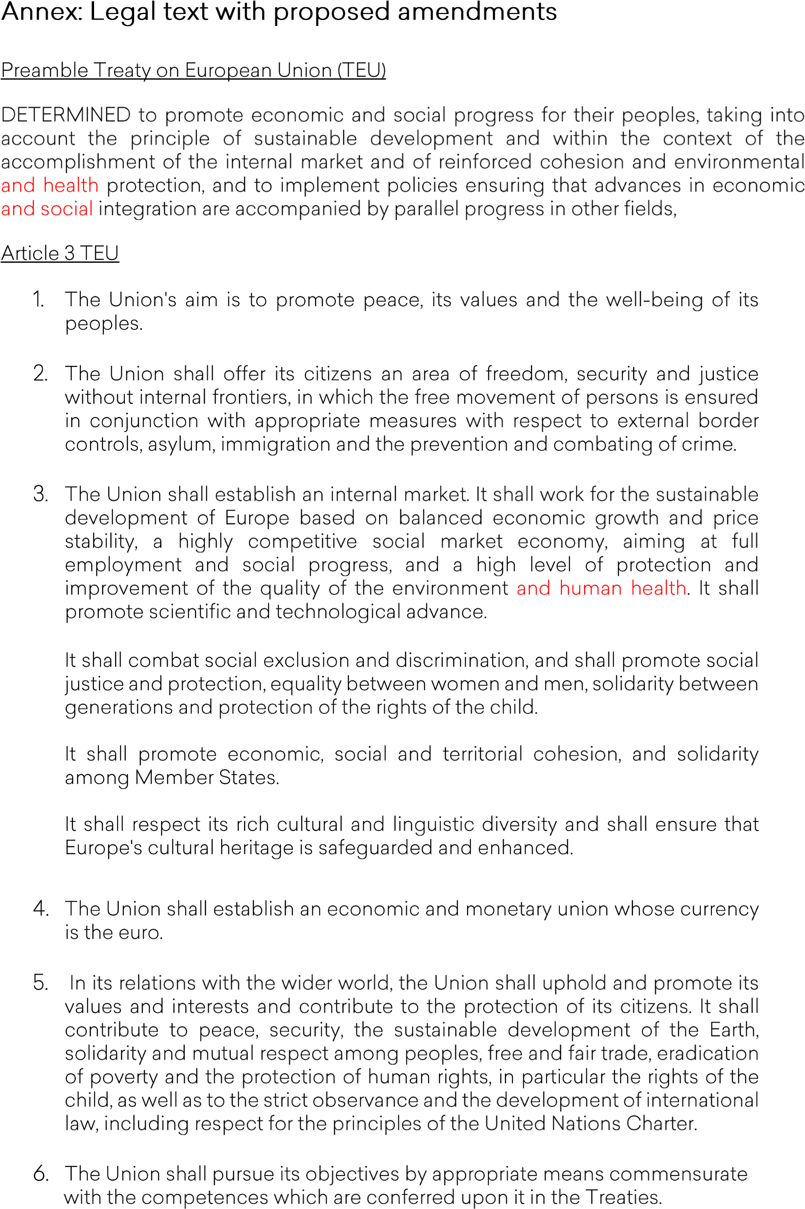

Slide 20
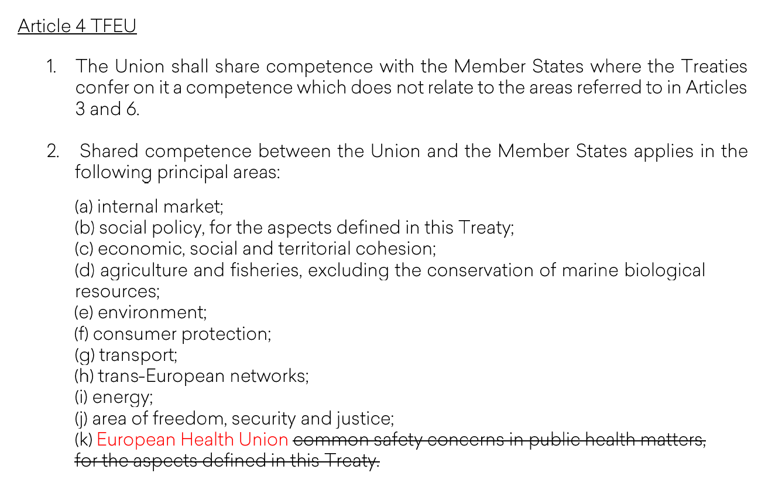

Slide 21
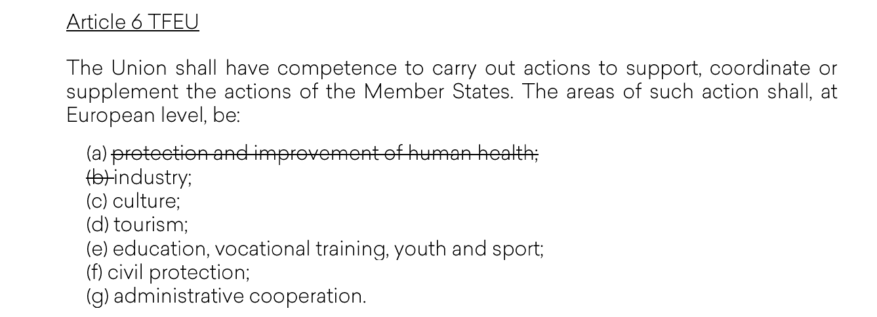

Slide 22
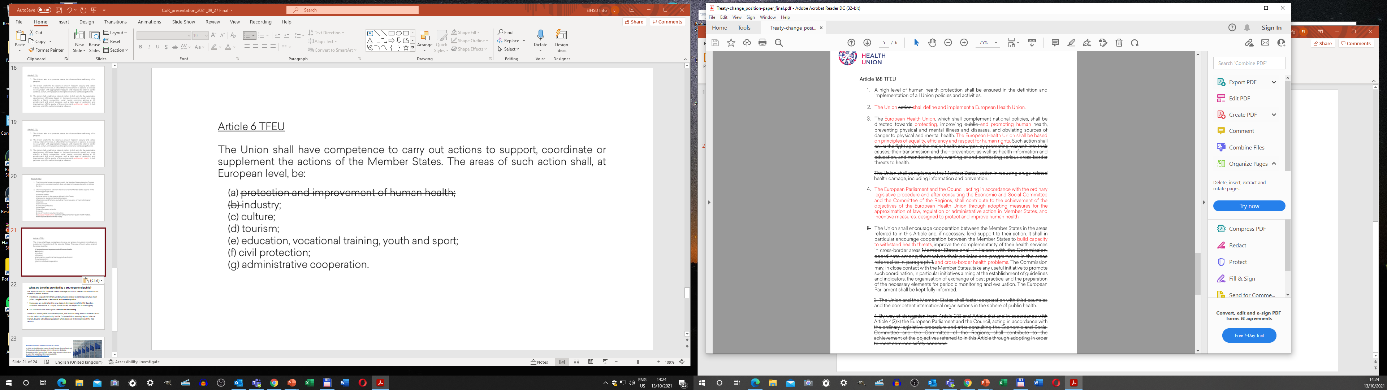
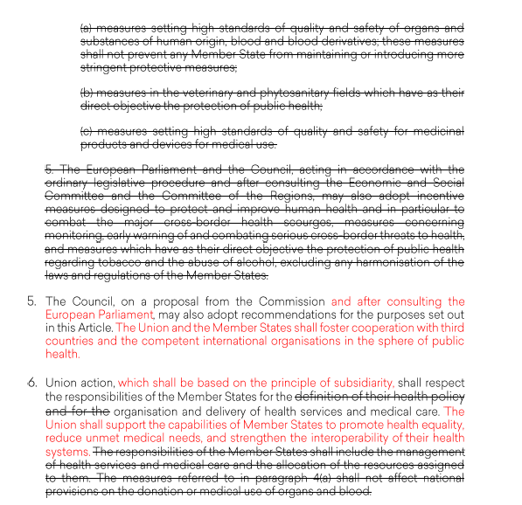

Slide 23
What are benefits provided by a EHU for non-health EU policies?
Strong European health policy is essential for filling European Pillar of Social Rights with a content desired by Europeans.
Today the US is using massive public financing via National Institutes of Health to create advantages for national producers of medical technologies. A EHU has potential to harness opportunities provided by population of 500 million and world biggest public finances for breakthroughs in innovation. Gains in competitiveness of European producers of medical goods and better employment opportunities for Europeans is going to be the externality of a EHU.
The EU has an ambition to lead the global health policy but with ought strong European cooperation on health the leadership can not be unsustainable. Today the EU is not a party of World Health Organisation. A genuine EHU has potential to strengthen external policy of the Bloc.

Slide 24
What are benefits provided by a EHU to general public?
The explicit stance for universal health coverage and EHU is needed for health but not limited by health matters:
EU citizens expect more than just deliverables related to contemporary two main pillars - single market or economic and monetary union.
Europeans are looking for the new stage of development of the EU. Based on humanist inheritance of Europe, on the values, on respect for human dignity
it is time to include a new pillar – health and well-being.
Some of us would prefer slow development, but without being ambitious there is a risk to miss a window of opportunity for the European Union evolving beyond internal market, beyond a traditional paradigm which does not fit the realities of the 21st century

Slide 25
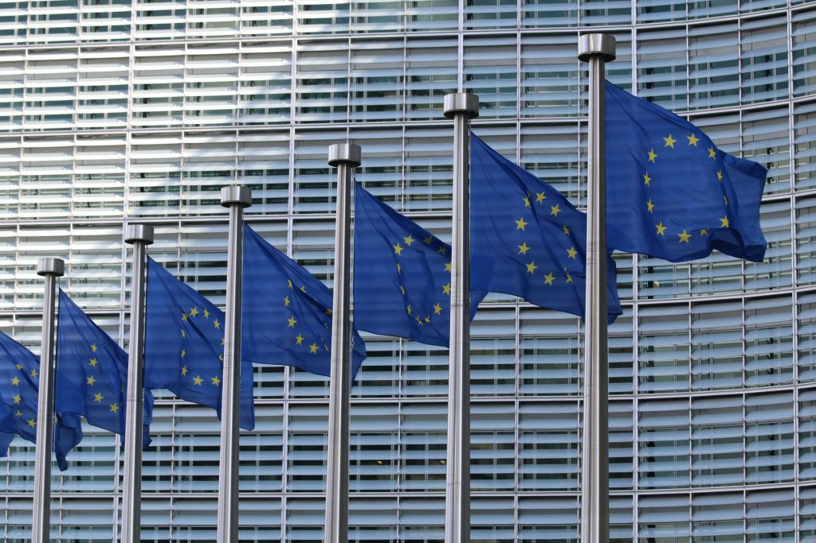
MANIFESTO FOR A EUROPEAN HEALTH UNION
In 2020, an invisible virus swept through Europe, leaving hundreds of thousands dead and many others with severe disability. Economic activity has crashed, forcing governments to intervene in ways that would have been unimaginable.
https://europeanhealthunion.eu/
Explanatory Memorandum to the MANIFESTO FOR A EUROPEAN HEALTH UNION
What is the Explanatory Memorandum about?
The Explanatory Memorandum has been prepared in order to assist the reader of the Manifesto and contribute to informed debate on it. It does not form a part of the Manifesto.
It explains what the Manifesto is calling for and provides background information on the its development.
The paper is best be read alongside the Manifesto. It is not, and is not intended to be, a comprehensive description of the Manifesto.
Position paper. Treaty change for a European Health Union
It presents legal text for the discussion on stronger European health policy: https://europeanhealthunion.eu/wp-content/uploads/2021/07/Treaty-Change-for-a-European-Health-Union.pdf

Slide 26
Thank you
It was an honour to be with You

